Slide 1
Context Free Grammar

Slide 2
A grammar is a formal mechanism used to describe how strings of a language are generated using a set of rules called productions.
It consists of terminals, non-terminals, a start symbol, and production rules.
A regular grammar is the simplest type of grammar, where:
  Each production has a single non-terminal on the left-hand side
  The right-hand side is highly restricted (a terminal followed by at most one non-terminal)
Regular grammars generate regular languages, which can be recognized by finite automata.

Slide 3
In a regular grammar, productions are restricted in two ways:the left-hand side must be a single variable, and the right-hand side has a special restricted form.
These restrictions limit the power of regular grammars in describing complex languages.
To generate more powerful grammars, some restrictions must be relaxed.
By retaining the restriction on the left-hand side (single non-terminal)and allowing any form on the right-hand side, we obtain Context-Free Grammars.

Slide 4
Formal Definition of Context-Free Grammar
A grammar G = (V, T, S, P) is said to be context-free if all productions in P are of the form:
  A → x
  where:
A ∈ V (A is a single non-terminal)
x ∈ (V ∪ T)* (x can be any string of terminals and/or non-terminals, including ε)
A language L is called context-free if and only if there exists a context-free grammar G such that:
L = L(G)

Slide 5
Every regular grammar is context-free, but not every context-free grammar is regular.
Examples of Regular Grammar
Grammar G:
S → aS | b
This is a regular grammar because:
Left-hand side is a single non-terminal
Right-hand side is of the form terminal or terminal + non-terminal
Language generated:
L = { aⁿb | n ≥ 0 }

Slide 6
Example of a Context-Free Grammar
Consider the grammar
G = ({S}, {a, b}, S, P) with productions:
S → aSa
S → bSb
S → ε
Typical Derivation
S ⇒ aSa ⇒ aaSaa ⇒ aabSbaa ⇒ aabbaa
This grammar is context-free because:
The left-hand side of every production is a single non-terminal
The right-hand side can be any string of terminals and/or non-terminals

Slide 7

Language Generated
$L\left(G\right)=\left\{ww^{R}∣w∈\left\{a , b{\left.\}\right.}^{∗}\right\}\right.$
That is, the set of palindromes over {a, b}.

Slide 8
Given Grammar
  S → abB
  A → aaBb | ε
  B → bbAa
Start with the start symbol S:
  S ⇒ abB
  ⇒ abbbAa (using B → bbAa)
  ⇒ abbbaaBba (using A → aaBb)
  ⇒ abbbaabbAaba (using B → bbAa)
  ⇒ abbbaabbaba (using A → ε)

Slide 9

Language Generated
$$L\left(G\right)=\left\{ ab\left(bbaa{\left.)\right.}^{n} bba \left(ba{\left.)\right.}^{n}∣n≥0 \right\}\right.\right.$$

Slide 10
Derivation Example
Grammar G
S → NP VP
NP → Det N
VP → V NP
Det → the | a
N → boy | girl
V → sees | likes
Derive the sentence “the boy sees a girl”

Slide 11
Start with S:
S ⇒ NP VP
⇒ Det N VP
⇒ the N VP
⇒ the boy VP
⇒ the boy V NP
⇒ the boy sees NP
⇒ the boy sees Det N
⇒ the boy sees a N
⇒ the boy sees a girl

Slide 12
Linear Grammar
A linear grammar is a type of context-free grammar in which each production contains at most one non-terminal on the right-hand side
A grammar G = (V, T, S, P) is called linear if every production is of the form:
A → xBy or
A → x
where:
A, B ∈ V (non-terminals)
x, y ∈ T* (strings of terminals)

Slide 13
Types of Linear Grammar
Right-Linear Grammar
  Non-terminal appears at the right end
  Example:
  S → aS | b
Left-Linear Grammar
  Non-terminal appears at the left end
  Example:
  S → Sa | b

Slide 14
Given Grammar
Productions:
S → aSb | SS | ε
This Grammar Is Context-Free because
  Each production has a single non-terminal (S) on the left-hand side
  Right-hand side can be any string of terminals and non-terminals
This Grammar Is NOT Linear since
  The production S → SS has two non-terminals on the right-hand side
  Linear grammars allow at most one non-terminal on the RHS

Slide 15
Leftmost and Rightmost Derivation
In context-free grammars that are not linear, a sentential form may contain more than one non-terminal. Hence, we must decide which non-terminal to replace first.
This gives rise to:
  Leftmost derivation
  Rightmost derivation

Slide 16
Leftmost Derivation
At each step, the leftmost non-terminal in the sentential form is replaced.
Rightmost Derivation
At each step, the rightmost non-terminal in the sentential form is replaced.

Slide 17

Example
Let
$G=\left(\left\{A , B , S\right\} , \left\{a , b\right\} , S , P\right)$
Productions:
S → AB
A → aaA
A → ε
B → Bb
B → ε

Slide 18
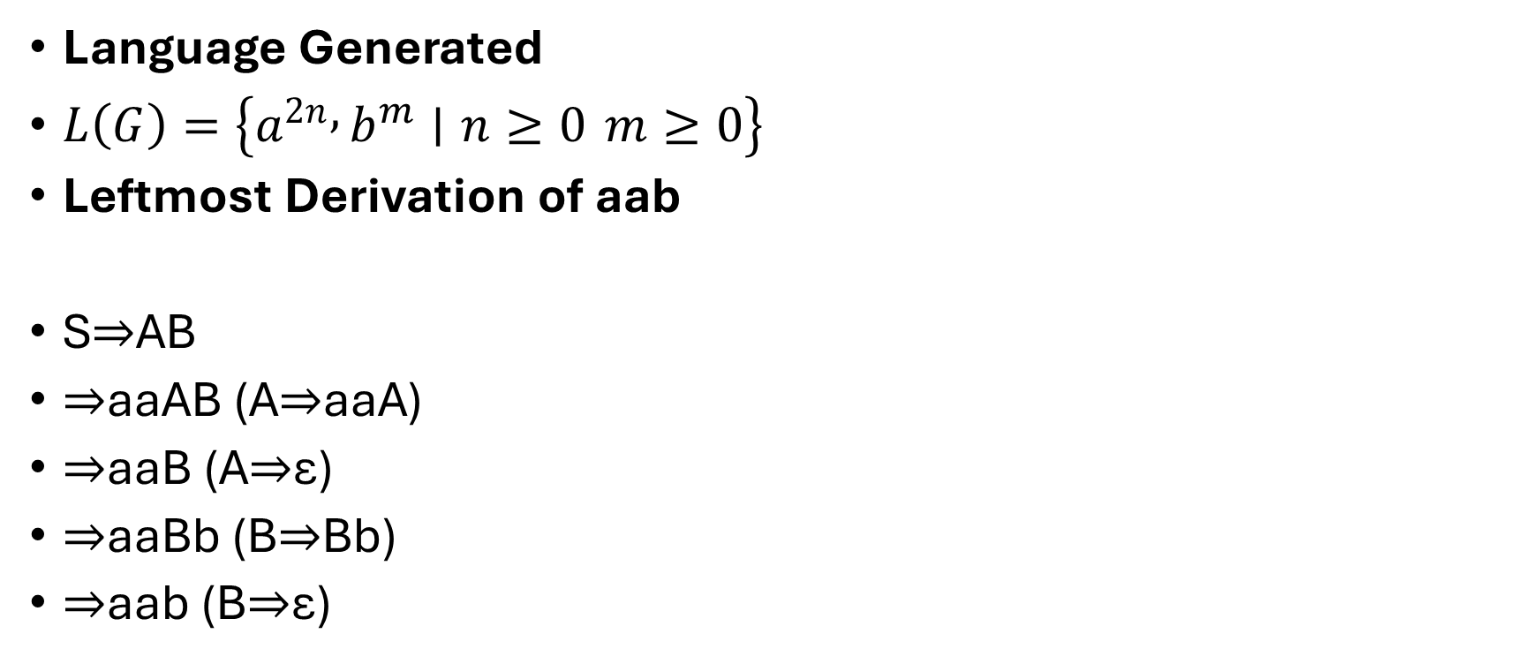
Language Generated
$L\left(G\right)=\left\{a^{2n} , b^{m}∣n≥0 m≥0\right\}$
Leftmost Derivation of aab
S​⇒AB
⇒aaAB (A⇒aaA)
⇒aaB (A⇒ε)
⇒aaBb (B⇒Bb)
⇒aab (B⇒ε)​

Slide 19
Rightmost Derivation of aab
S​⇒AB
⇒Abb (B⇒Bb)
⇒Ab (B⇒ε)
⇒aaAb (A⇒aaA)
⇒aab (A⇒ε)​
Both derivations use the same productions and produce the same string.
The difference lies only in the order in which non-terminals are expanded

Slide 20
Example 1
Derive the string (a + (a * a)) using Left Most derivation and Right most derivation for the following productions:
E → E + E | E * E | (E) | a
Soln: String = (a + (a * a))
RMD: E ==>_{rm} (E)
==>_{rm} (E + E)
==>_{rm} (E + (E))
==>_{rm} (E + (E * E))
==>_{rm} (E + (E * a))
==>_{rm} (E + (a * a))
==>_{rm} (a + (a * a))
E ==>_{rm} * (a + (a * a))
LMD: E ==>_{lm} (E)
==>_{lm} (E + E)
==>_{lm} (a + E)
==>_{lm} (a + (E))
==>_{lm} (a + (E * E))
==>_{lm} (a + (a * E))
==>_{lm} (a + (a * a))
E ==>_{lm} * (a + (a * a))

Slide 21
Example
Given Grammar Productions: S → aAB A → bBb B → A | ε | _{S​⇒aAB} _{⇒abBbB (A⇒bBb)} _{⇒abAbB (B⇒A)} _{⇒abbBbb (A⇒bBb)} _{⇒abbbbB (B⇒ε)} _{⇒abbbb (B⇒ε)​} This is a leftmost derivation of abb | _{S​⇒aAB} _{⇒aA (B⇒ε)} _{⇒abBb (A⇒bBb)} _{⇒abAb (B⇒A)} _{⇒abbBbb (A⇒bBb)} _{⇒abbbb (B⇒ε)​} This is a rightmost derivation of the same string.

Slide 22
Derivation Tree (Parse Tree)
A derivation tree is a graphical way of representing a derivation.
It is an ordered tree in which:
  Each internal node is labeled with a non-terminal (left-hand side of a production)
  The children of a node represent the symbols on the right-hand side of that production
  Leaves are terminal symbols (or ε)

Slide 23
The root of the tree is labeled with the start symbol
Each variable is expanded according to a production rule
The derivation ends when all leaves are terminals
Reading the leaves from left to right gives the derived string

Slide 24
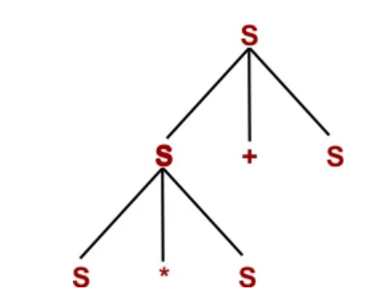
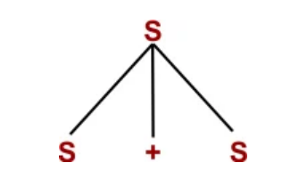
Example
Production rules of a Grammar (G)
S → S + S | S * S
S → x|y|z
Derive the string (x * y + Z)
Step 1: By using S → S + S Step 2: By using S → S * S

Slide 25
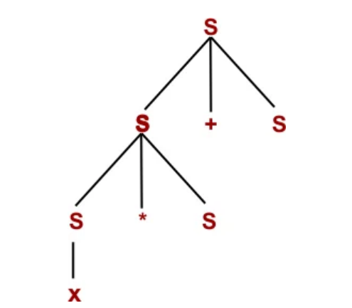
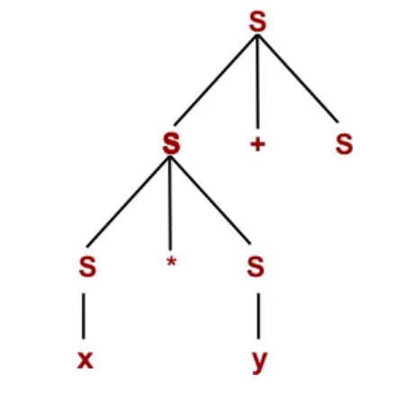
Step 3: By using S → x
Step 4: By using S → y

Slide 26
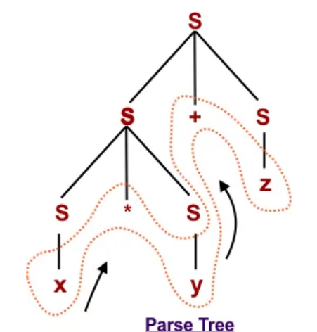
Step 5: By using S → z

Slide 27
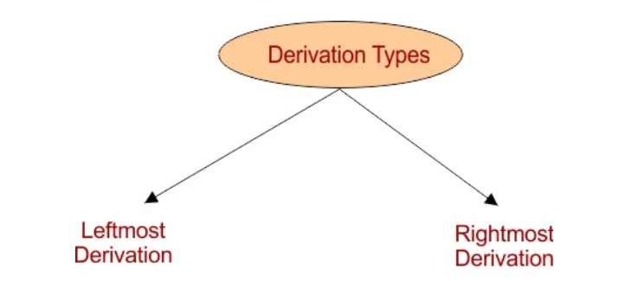
Types of Derivation

Slide 28
Leftmost Derivation Tree
In a leftmost derivation, at each step, the leftmost non-terminal in the current string is expanded first using a production rule.
This method is useful in top-down parsing techniques, like recursive descent parsers.
Here is descriptive diagram of the leftmost derivation tree

Slide 29
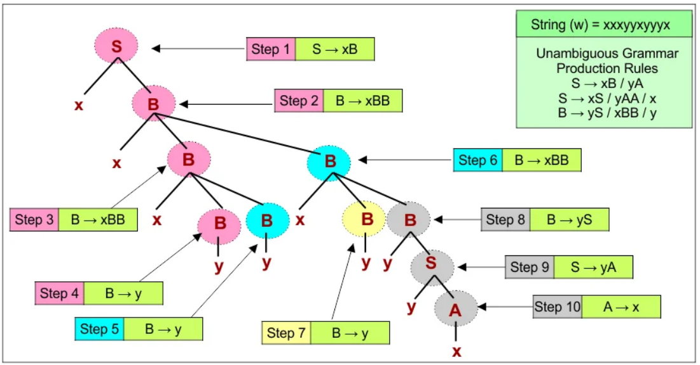

Slide 30
Rightmost Derivation Tree
In a rightmost derivation, at each step, the rightmost non-terminal in the current string is expanded first.
Rightmost derivations are commonly used in bottom-up parsing algorithms, such as shift-reduce parsers.

Slide 31
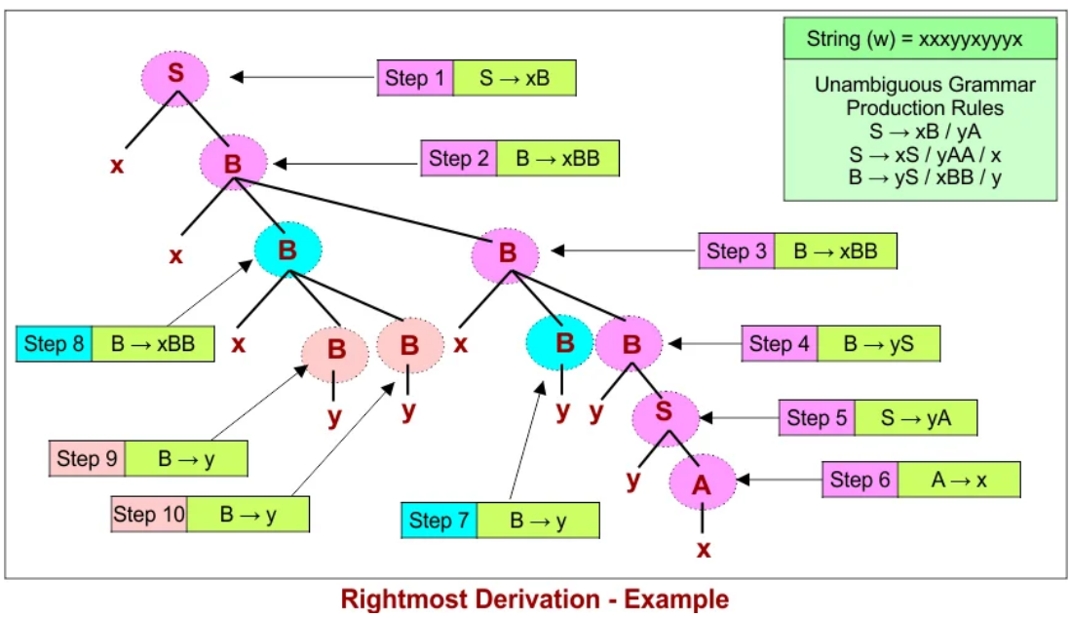

Slide 32
Ambiguity in Derivation Trees
A grammar is called ambiguous if there exists at least one string in the language that can be generated by two or more different derivation trees (or parse trees).
Example:
Production rules: S → xB | xy , A → AB | x , B → Ayy | y
Given string (W) to derive: xy.

Slide 33
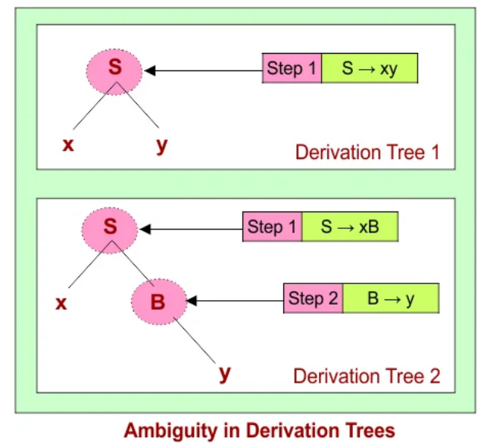

Slide 34
Ambiguity means there are multiple ways to apply production rules to derive the same string, leading to different tree structures.
Ambiguous grammars can cause confusion in parsing, as the meaning or structure of the string is not uniquely defined, which is undesirable for programming languages.

Slide 35
Partial Derivation Tree
A partial derivation tree is a derivation tree in which at least one leaf node is a non-terminal, representing an intermediate stage of string derivation in a context-free grammar.

Slide 36
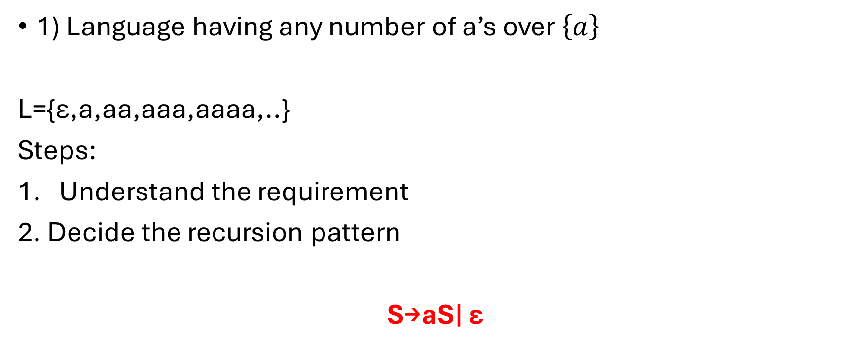
Construction of CFG
1) Language having any number of a’s over $\left\{a\right\}$
L={ε,a,aa,aaa,aaaa,..}
Steps:
Understand the requirement
2. Decide the recursion pattern
S→aS∣ ε

Slide 37

2) Any number of a’s and b’s
L={ϵ, a, b, ab, ba, aab, bba, abab, aaabbb, …}
S→aS∣bS∣ϵ.
3) Atleast two a’s

Slide 38
We must ensure:
two a’s appear
after that, anything is allowed
S → AaAaA
A → aA|bA| ϵ

Slide 39
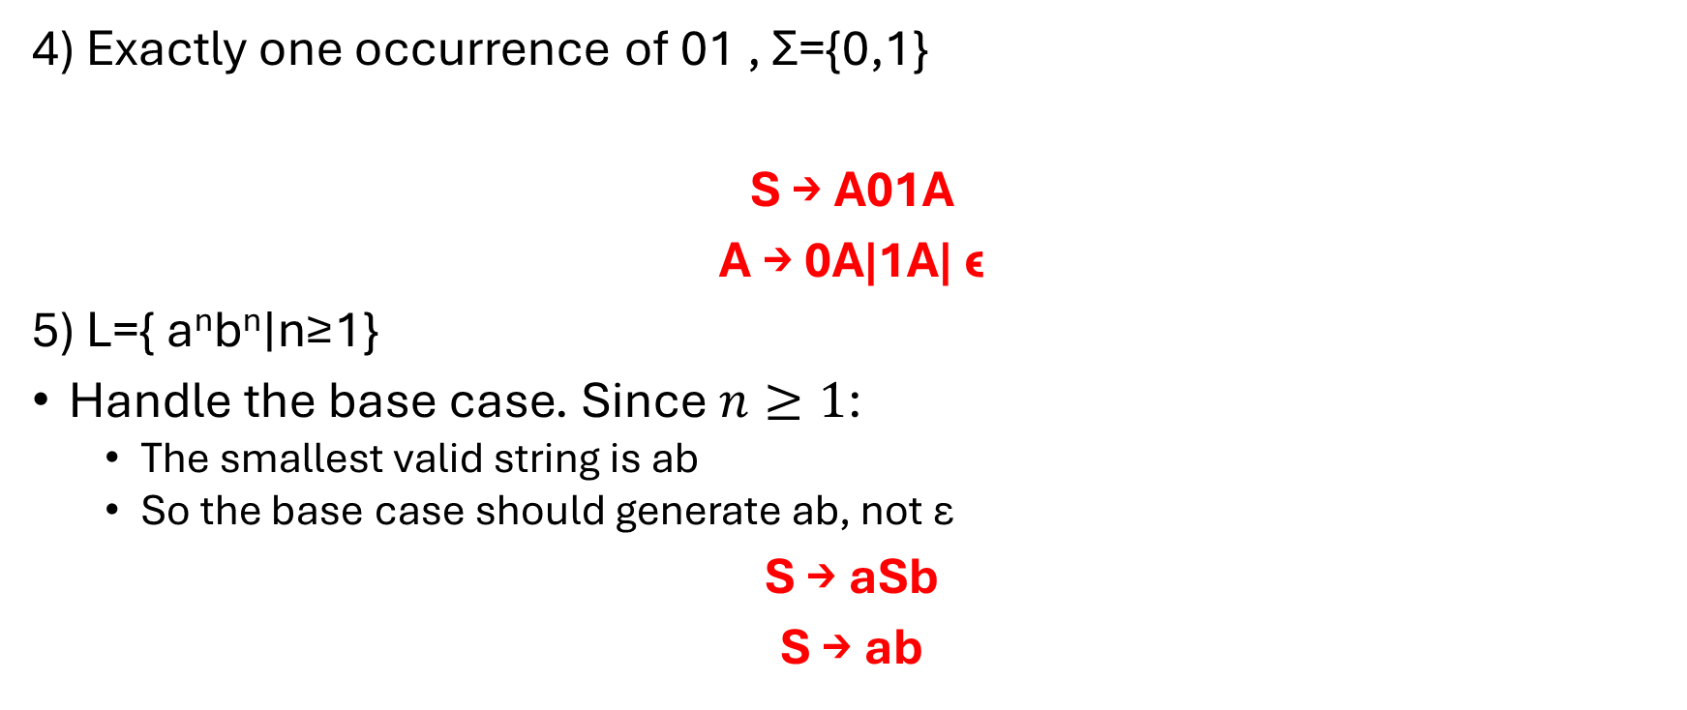
4) Exactly one occurrence of 01 , Σ={0,1}
S → A01A
A → 0A|1A| ϵ
5) L={ a^{n}b^{n}∣n≥1}
Handle the base case. Since $n≥1$:
  The smallest valid string is ab
  So the base case should generate ab, not ε
S → aSb
S → ab

Slide 40
6) L=a^{n}b^{2n}∣n≥1
S→ aSbb
S→ abb
7) L= wcw^{T}| w belongs to {a,b}*
L={abbcbba, aca, bcb, bacab,..}
S→ aSa|bSb
S → c

Slide 41
8) L=a^{n}b^{m}c^{n}∣m,n≥1
S→aSc∣aBc
B→bB∣b
9) L=a^{n}b^{m}c^{m}d^{n}∣m,n≥1
S→aSd∣aAd
A→bAc∣bc

Slide 42
L=a^{n}b^{n}c^{m}d^{m}∣m,n≥1
S→AB
A → aAb|ab
B→cBd|cd

Slide 43
L={a^{m+n}b^{m}c^{n}, n,m≥1}
L={a^{n}a^{m}b^{m}c^{n} }
S→aSc|aAc
A → aAb|ab

Slide 44
Simplifying Grammars
Context-free grammars allow flexible production rules, but unrestricted forms can make analysis difficult.
Introducing suitable restrictions helps simplify grammar analysis and theoretical proofs.
Any context-free grammar can be transformed into an equivalent restricted grammar.
Normal forms provide a standard structure while preserving the expressive power of the grammar.
Chomsky normal form and Greibach normal form are important normal forms used in theory and parsing.

Slide 45
Methods to reduce grammar
i) Removing useless productions
Ii) Remiving Null Productions
Iii) Removing unit productions

Slide 46
Removing useless productions
Some productions in a grammar never participate in any valid derivation and can be safely removed.
A production that cannot lead to a terminal string does not contribute to sentence generation.
Removing such productions simplifies the grammar without changing the language.
A variable in a context-free grammar is considered useful if it appears in at least one derivation that produces a string in the language.

Slide 47
A variable that does not appear in any successful derivation is called useless.
Any production involving a useless variable is also considered useless.
Eliminating useless variables and productions results in a simpler and equivalent grammar.

Slide 48
Example
S → A, A → aA | λ, and B → bA.
A variable may be useless if it cannot derive any terminal string.
A variable may also be useless if it cannot be reached from the start symbol.
In this grammar, the variable B can derive terminal strings but is unreachable from S.
Since B never appears in any derivation starting from S, it does not contribute to sentence generation.
Therefore, B and the production involving B can be safely removed.
A variable is useless either because it is non-generating or because it is unreachable.

Slide 49
Example 2
The given grammar has variables V = {S, A, B, C}, terminals T = {a, b}, and start symbol S.
The production rules of the grammar are
S → aS | A | C,
A → a,
B → aa, and
C → aCb.

Slide 50
The first step is to identify variables that can derive at least one terminal string.
Variable A is generating because A → a. Variable B is generating because B → aa. Variable S is generating because S ⇒ A ⇒ a. Variable C is non-generating because C → aCb always contains C and cannot derive a terminal string.
Since C is non-generating, C and all productions involving C are removed.
After removing C, the intermediate grammar has variables {S, A, B}, terminals {a}, and productions S → aS | A, A → a, and B → aa.
The next step is to identify variables that are reachable from the start symbol S.
Variable A is reachable from S through the production S → A.
Variable B is not reachable from S because no production from S leads to B.
Since B is unreachable, B and its production are removed. The final grammar after eliminating all useless symbols has variables {S, A}, terminals {a}, and productions
S → aS | A and A → a.

Slide 51
Example 3
S → AB | AC
A → aAb | bAa | ab
B → bbA | aaB | AB
C → abCA | aDb
D → bD | aC
Variable A is generating because A → ab produces only terminals.
Variable B, Since A is generating,
bbA ⇒ bbab (terminals)
Variable C is non-generating because every production of C contains C or D.
Variable D is non-generating because D → bD | aC always contains D or C.
Variable S is generating because S → AB and A is generating, but this will be rechecked after removing non-generating symbols.

Slide 52
Remove non-generating variables and related productions.
  Variables C, and D are non-generating and are removed.
  All productions containing C, or D are eliminated.
  After removal, the remaining variables are {S, A}.
  The remaining productions are S → A and A → aAb | bAa | ab and B -> bbA| aaB | AB
Identify reachable variables from the start symbol.
  Variable S is reachable as it is the start symbol.
  Variable A is reachable from S through the production S → A.
Final grammar after eliminating useless symbols and productions.
  Variables: {S, A} Terminals: {a, b}
  Productions:
  S → AB
  A → aAb | bAa | ab
  B -> bbA| aaB | AB

Slide 53
Removing λ| ε productions
Some context-free grammar productions are undesirable because their right-hand side is the empty string.
A production of the form A → λ is called a lambda production.
A variable is called nullable if it can derive the empty string.
A grammar may contain lambda productions even if the language itself does not include the empty string.
In such cases, lambda productions can be systematically removed.
Removing lambda productions simplifies the grammar while preserving the generated language.

Slide 54
Algorithm to remove λ| ε productions
Identify all nullable variables, which are variables that can derive ε.
Initialize the set of nullable variables with all variables that have productions of the form A → ε.
Iteratively add a variable A to the nullable set if A → X₁X₂…Xₙ and every Xᵢ in the production is nullable.
For each production A → α, generate new productions by deleting any subset of nullable variables from α.
Do not include the production A → ε unless the start symbol derives ε in the original grammar.
If the start symbol is nullable, introduce a new start symbol S₀ and add productions S₀ → S and S₀ → ε.
Remove all original ε-productions from the grammar.
The resulting grammar is equivalent to the original grammar without λ-productions.

Slide 55
Example
S → aS₁b and
S₁ → aS₁b | ε.
The variable S₁ is nullable because it can derive the empty string
To remove the λ-production, substitute ε for S₁ wherever it appears on the right-hand side. The λ-production S₁ → ε is then removed from the grammar.
The resulting grammar has productions
  S → aS₁b | ab
  S₁ → aS₁b | ab.

Slide 56
Example
Remove Null Production
S → ABaC
A → BC
B → b | λ
C → D | λ
D → d
Nullable variables are A, B, and C, and all possible productions are generated by removing nullable symbols from the right-hand sides.

Slide 57
Final grammar after removing λ-productions
S → ABaC | BaC | AaC | ABa | aC | Aa | Ba | a
A → B | C | BC
B → b
C → D
D → d

Slide 58
Remove Unit Productions
Some context-free grammar productions are undesirable when both sides consist of a single variable.
A production of the form
A → B,
where A and B are variables, is called a unit production.
Unit productions do not directly contribute to terminal string generation.
Such productions can increase the length of derivations without adding useful structure.
Therefore, unit productions are usually removed to simplify the grammar while preserving the language.

Slide 59
Algorithm to remove unit productions
Identify all unit productions of the form A → B, where A and B are variables.
For each variable A, compute the set of variables that can be reached from A using only unit productions.
For every pair of variables (A, B) such that B is reachable from A by unit productions, add to A all non-unit productions of B.
Ensure that productions added do not create duplicate rules.
Remove all original unit productions from the grammar.
The resulting grammar generates the same language but contains no unit productions.

Slide 60
Example
Given grammar
S → A
A → B
B → a
S → A and A → B are unit productions.
From S, we can reach A and B using unit productions.
From A, we can reach B using a unit production.
Since B → a is a non-unit production, add it to both A and S.
So we add:
A → a
S → a

Slide 61
Remove S → A and A → B.
Final grammar
S → a
A → a
B → a

Slide 62
Example
Remove Unit Production
S → AB
A → a
B → C | b
C → D
D → E
E → a

Slide 63
Answer:
A → a
B → b|a
C → a
D → a
E → a

Slide 64
Example
S → Aa | B
B → A | bb
A → a | bc | B
Identify unit productions
S → B
B → A
A → B
So there is a unit-production cycle among A and B, and S also reaches them.

Slide 65
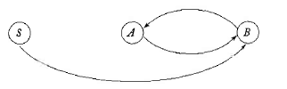
Non-unit productions in the grammar are:
  S → Aa
  A → a | bc
  B → bb
Because of unit reachability:
S gets the non-unit productions of A andd B
A gets the non-unit productions of B
B gets the non-unit productions of A
So we add:
S → a | bc | bb
A → bb
B → a | bc

Slide 66
Final grammar after removing unit productions
S → a | bc | bb | Aa
A → a | bc | bb
B → a | bc | bb

Slide 67
Normal forms of CFG
Types
  Chomsky Normal Form (CNF)
  Greibach Normal Form (GNF)

Slide 68
1. Chomsky Normal Form (CNF)
A CFG is in CNF where all the productions are of the form
A → a [One Terminal]
A →BC [Two Non-terminal]
Where A, B, C → Variables / Non-terminals
a → terminals

Slide 69
Converting CFG to CNF
To make a CFG as CNF, the following simplifications are to made:
  Eliminate useless symbols
  Eliminate ε-production
  Eliminate unit production

Slide 70
Steps to convert a context-free grammar into Chomsky Normal Form (CNF):
Simplify the grammar by eliminating useless symbols, ε-productions, and unit productions.
Convert all productions into either A → BC or A → a form, where the right-hand side contains either exactly two non-terminals or a single terminal.
If a production is of the form A → X₁X₂…Xₖ, where k ≥ 2, introduce new variables to break it into binary productions as follows:
A → X₁Y₁,
Y₁ → X₂Y₂,
Y₂ → X₃Y₃,
…
Yₖ₋₂ → Xₖ₋₁Xₖ.

Slide 71
Problem 1
Find the CNF for the following grammar:
S → aB | bA
A→ aS | bAA | a
B → bS | aBB | b
1.Remove Useless Symbols
The useless symbols are identified by finding the generating and reachable symbols.
The set of generating symbols is {a, b, A, B, S}.
The set of reachable symbols is {S, a, B, b, A}.
Since every symbol is both generating and reachable, the given grammar has no useless symbols.

Slide 72
2. Elimination of ε-productions
To eliminate ε-productions, it is necessary to identify nullable symbols.
The grammar contains no ε-productions and hence has no nullable symbols.
Therefore, no ε-production elimination is required.
3. Elimination of unit productions
The next step is to eliminate unit productions.
The unit pairs in the grammar are (S, S), (A, A), and (B, B).

Slide 73
The final grammar in CNF is:
S → C₁B | C₂A
A → C₁S | C₂C₃ | a
B → C₂S | C₁C₄ | b
Where
C₁ → a
C₂ → b
C₃ → AA
C₄ → BB
S → C₁B | C₂A

Slide 74
Problem 2
S → AB | aB
A → aab | ε
B → bbA
1. Eliminate useless productions
The first step is to eliminate useless symbols by identifying generating and reachable symbols.
The set of generating symbols is {a, b, A, B, S}, since A → ε implies A is generating, and hence B and S are also generating.
The set of reachable symbols is {S, A, B, a, b}.
Since every symbol is both generating and reachable, the given grammar has no useless symbols.

Slide 75
2: Elimination of ε-productions
The second step is to eliminate ε-productions by identifying nullable symbols.
In the given grammar, the variable A is a nullable symbol since A → ε.
After eliminating the ε-production, the grammar becomes:
S → AB | aB | B
A → aab
B → bbA | bb

Slide 76
Removing unit production
S → AB | aB | bbA | bb
A → aab
B → bbA | bb

Slide 77
The CNF grammar is as follows:
S → AB | C₁B | C₂C₃ | C₂C₂
A → C₁C₄
B → C₂C₃ | C₂C₂
C₁ → a
C₂ → b
C₃ → C₂A
C₄ → C₁C₂

Slide 78
Greibach Normal Form (GNF)
A grammar is said to be in Greibach Normal Form if its language L(G) is a non-empty language that does not contain ε, and every production of the grammar is of the form
A → aα
where ‘a’ is a terminal symbol and ‘α’ is a (possibly empty) string of non-terminal symbols.

Slide 79
Before converting a context-free grammar into Greibach Normal Form, it is necessary to first check whether the grammar is in Chomsky Normal Form.
CFG → CNF → GNF
Steps to convert CFG to CNF
Rule 1
If a grammar has a production of the form
A → αBβ
and
B → γ₁ | γ₂ | … | γₙ,
then the production can be rewritten as
A → αγ₁β | αγ₂β | … | αγₙβ.

Slide 80
Rule 2
If the grammar has productions of the form
A → Aα₁ | Aα₂ | … | Aαₙ | β₁ | β₂ | … | βₙ,
then it can be rewritten as
B → α₁ | α₂ | … | αₙ | α₁B | α₂B | … | αₙB,
A → β₁ | β₂ | … | βₙ | β₁B | β₂B | … | βₙB,
where B is a new non-terminal.

Slide 81
Steps to Convert CFG to GNF
Check whether the given grammar is a context-free grammar and whether it is in Chomsky Normal Form.
If not, first convert the CFG into CNF.
Rename all variables of the grammar as A₁, A₂, …, Aₙ, such that the start symbol is assigned A₁ and the remaining variables are ordered accordingly.
After renaming, every production will be of the form Aᵢ → Aⱼβ where there are three possible cases:
  i < j,
  i > j, or
  i = j.

Slide 82
Handle each case as follows:
a) If i < j, leave the production unchanged.
b) If i > j, apply Rule 1.
c) If i = j, apply Rule 2.
Repeat Step 3 and Step 4 until all productions are processed and every production is of the form A → aα.
The newly generated productions form a grammar G′ such that L(G) = L(G′),where G is the original CFG and G′ is the grammar in GNF.

Slide 83
Problem 1
Convert the following grammar into GNF:
S → AA | 0
A → SS | 1
Soln:
Step1 : Check whether the CFG is in CNF.
YES, given CFG is in CNF
Step 2: Assign new names to Non-terminals – S, A
S → A₁
A → A₂
The modified production:
A₁ → A₂ A₂ | 0 ---> (1)
A₂ → A₁ A₁ | 1 ---> (2)

Slide 84
Production (1)
A₁ → A₂A₂ | 0
Here, i = 1 and j = 2, so i < j.
Hence, no change is required.
Production (2)
A₂ → A₁A₁ | 1
Here, i = 2 and j = 1, so i > j.
Apply Rule 1 by substituting the productions of A₁.
Using A₁ → A₂A₂ | 0, we get:
A₂ → A₂A₂A₁ | 0A₁ | 1
Production (3)
In the production A₂ → A₂A₂A₁ | 0A₁ | 1,
the case i = j occurs for the term A₂A₂A₁.
Apply Rule 2 to eliminate left recursion.

Slide 85
(2) B₂ → A₂A₁ | A₂A₁B₂
(3) A₂ → 0A₁ | 1 | 0A₁B₂ | 1B₂
Substituting (3) in (1)
After substituting the productions of A₂ in A₁, we obtain:
A₁ → 0A₁A₂ | 1A₂ | 0A₁B₂A₂ | 1B₂A₂ | 0
Substituting (3) in (2)
After substituting the productions of A₂ in B₂, we obtain:
B₂ → 0A₁A₁ | 1A₁ | 0A₁B₂A₁ | 1B₂A₁
| 0A₁A₁B₂ | 1A₁B₂ | 0A₁B₂A₁B₂ | 1B₂A₁B₂
[GNF form]

Slide 86
The GNF grammar is
A₁ → 0A₁A₂ | 1A₂ | 0A₁B₂A₂ | 1B₂A₂ | 0
A₂ → 0A₁ | 1 | 0A₁B₂ | 1B₂
B₂ → 0A₁A₁ | 1A₁ | 0A₁B₂A₁ | 1B₂A₁
| 0A₁A₁B₂ | 1A₁B₂ | 0A₁B₂A₁B₂ | 1B₂A₁B₂

